Slide 1
CSE 486/586 Distributed Systems Google Chubby Lock Service
Steve Ko
Computer Sciences and Engineering
University at Buffalo

Slide 2
Recap
Paxos is a consensus algorithm.
Proposers?
Acceptors?
Learners?
A proposer always makes sure that,
If a value has been chosen, it always proposes the same value.
Three phases
Prepare: “What’s the last proposed value?”
Accept: “Accept my proposal.”
Learn: “Let’s tell other guys about the consensus.”

Slide 3
Recap: First Requirement
In the absence of failure or msg loss, we want a value to be chosen even if only one value is proposed by a single proposer.
P1. An acceptor must accept the first proposal that it receives.

Slide 4
Recap: Second Requirement
But the first requirement is not enough!
There are cases that do not provide any consensus.
We need to accept multiple proposals.
Then we need to guarantee that once a majority chooses a value, all majorities should choose the same value.
I.e., all chosen proposals have the same value.
This guarantees only one value to be chosen.
This gives our next requirement.
P2. If a proposal with value V is chosen, then every higher-numbered proposal that is chosen has value V.

Slide 5
Recap: Strengthening P2
OK; how do we guarantee that?
Can acceptors do something?
Yes!
So we can strengthen P2:
P2a. If a proposal with value V is chosen, then every higher-numbered proposal accepted by any acceptor has value V.
By doing this, we have change the requirement to be something that acceptors need to guarantee.

Slide 6
Recap: Strengthening P2
But guaranteeing P2a might be difficult because of P1.
Scenario
A value V is chosen.
An acceptor C never receives any proposal (due to asynchrony).
A proposer fails, recovers, and issues a different proposal with a higher number and a different value.
C accepts it (violating P2a).

Slide 7
Recap: Combining P1 & P2a
Then can proposers do anything about that?
P2b. If a proposal with value V is chosen, then every higher-numbered proposal issued by any proposer has value V.
Now we have changed the requirement P2 to something that each proposer has to guarantee.

Slide 8
How to Guarantee P2b
P2b. If a proposal with value v is chosen, then every higher-numbered proposal issued by any proposer has value V.
Two cases for a proposer proposing (N, V)
If a proposer knows that there is and will be no proposal N’ < N chosen by a majority, it can propose any value.
If that is not the case, then it has to make sure that it proposes the same value that’s been chosen by a majority.
(Rough) Intuition for the first case
If there’s a proposal chosen by a majority set S, then any majority set S’ will intersect with S.
Thus, if the proposer asks acceptors and gets replies from a majority that it did not and will not accept any proposal, then we’re fine.

Slide 9
“Invariant” to Maintain
P2c. For any V and N, if a proposal with value V and number N is issued, then there is a set S consisting of a majority of acceptors such that either
(A) no acceptor in S has accepted or will accept any proposal numbered less than N or,
(B) V is the value of the highest-numbered proposal among all proposals numbered less than N accepted by the acceptors in S.

Slide 10
Paxos Phase 1
A proposer chooses its proposal number N and sends a prepare request to acceptors.
Maintains P2c.
Acceptors need to reply:
A promise to not accept any proposal numbered less than N any more (to make sure that the protocol doesn’t deal with old proposals)
If there is, the accepted proposal with the highest number less than N

Slide 11
Paxos Phase 2
If a proposer receives a reply from a majority, it sends an accept request with the proposal (N, V).
V: the highest N from the replies (i.e., the accepted proposals returned from acceptors in phase 1)
Or, if no accepted proposal was returned in phase 1, any value.
Upon receiving (N, V), acceptors need to maintain P2c by either:
Accepting it
Or, rejecting it if there was another prepare request with N’ higher than N, and it replied to it.

Slide 12
Paxos Phase 3
Learners need to know which value has been chosen.
Many possibilities
One way: have each acceptor respond to all learners
Might be effective, but expensive
Another way: elect a “distinguished learner”
Acceptors respond with their acceptances to this process
This distinguished learner informs other learners.
Failure-prone
Mixing the two: a set of distinguished learners

Slide 13

Problem: Progress (Liveness)
There’s a race condition for proposals.
P0 completes phase 1 with a proposal number N0
Before P0 starts phase 2, P1 starts and completes phase 1 with a proposal number N1 > N0.
P0 performs phase 2, acceptors reject.
Before P1 starts phase 2, P0 restarts and completes phase 1 with a proposal number N2 > N1.
P1 performs phase 2, acceptors reject.
…(this can go on forever)
How to solve this?

Slide 14
Providing Liveness
Solution: elect a distinguished proposer
I.e., have only one proposer
If the distinguished proposer can successfully communicate with a majority, the protocol guarantees liveness.
I.e., if a process plays all three roles, Paxos can tolerate failures f < 1/2 * N.
Still needs to get around FLP for the leader election, e.g., having a failure detector

Slide 15
CSE 486/586 Administrivia
More practice problems & example final posted
Quick poll: Android platform class
PhoneLab hiring
Testbed developer/administrator
Anonymous feedback form still available.
Please come talk to me!

Slide 16
Google Chubby
A lock service
Enables multiple clients to share a lock and coordinate
A coarse-grained lock service
Locks are supposed to be held for hours and days, not seconds.
In addition, it can store small files.
Design target
Low-rate locking/unlocking
Low-volume information storage
Why would you need something like this?

Slide 17
Google Infrastructure Overview
Google File System (GFS)
Distributed file system
Bigtable
Table-based storage
MapReduce
Programming paradigm & its execution framework
These rely on Chubby.
Warning: the next few slides are intentionally shallow.
The only purpose is to give some overview.

Slide 18
Google File System
A cluster file system
Lots of storage (~12 disks per machine)
Replication of files to combat failures
CPU
CPU
CPU
CPU
CPU
CPU
CPU
CPU
CPU
CPU
CPU
CPU
CPU
CPU
CPU
CPU
CPU
CPU
CPU
CPU
CPU
CPU

Slide 19
Google File System
Files are divided into chunks
64MB/chunk
Distributed & replicated over servers
Two entities
One master
Chunk servers

Slide 20
Google File System
Master maintains all file system metadata
Namespace
Access control info
Filename to chunks mappings
Current locations of chunks
Master replicates its data for fault tolerance
Master periodically communicates with all chunk servers
Via heartbeat messages
To get state and send commands
Chunk servers respond to read/write requests & master’s commands.

Slide 21
Bigtable
Table-based storage on top of GFS
Main storage for a lot of Google services
Google Analytics
Google Finance
Personalized search
Google Earth & Google Maps
Etc.
Gives a large logical table view to the clients
Logical tables are divided into tablets and distributed over the Bigtable servers.
Three entities
Client library
One master
Tablet servers

Slide 22
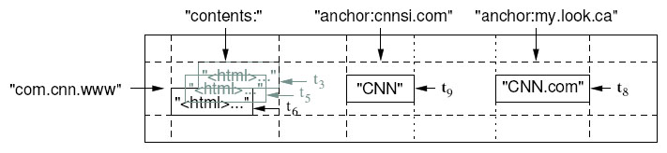
Bigtable
Table: rows & columns
(row, column, timestamp) -> cell contents
E.g., web pages and relevant info.
Rows: URLs
Columns: actual web page, (out-going) links, (incoming) links, etc.
Versioned: using timestamps

Slide 23
MapReduce
Programming paradigm
Map: (key, value) → list of (intermediate key, intermediate value)
Reduce: (intermediate key, list of intermediate values) → (output key, output value)
Programmers write Map & Reduce functions within the interface given (above).
Execution framework
Google MapReduce executes Map & Reduce functions over a cluster of servers
One master
Workers

Slide 24
MapReduce
Execution flow
Master
Input files sent to map tasks
Intermediate keys partitioned into reduce tasks
M
R
M
Input Files
R
Output
M
Reduce workers
Map workers

Slide 25
Common Theme
One master & multiple workers
Why one master?
This design simplifies lots of things.
Mainly used to handle meta data; it’s important to reduce the load of a single master.
No need to deal with consistency issues
Mostly fit in the memory → very fast access
Obvious problem: failure
We can have one primary and backups.
We can then elect the primary out of the peers.
How would you use a lock service like Chubby?

Slide 26
Chubby
A coarse-grained lock service
Locks are supposed to be held for hours and days, not seconds.
In addition, it can store small files.
Used for various purposes (e.g., the master election) for GFS, Bigtable, MapReduce
Potential masters try to create a lock on Chubby
The first one that gets the lock becomes the master
Also used for storing small configuration data and access control lists

Slide 27
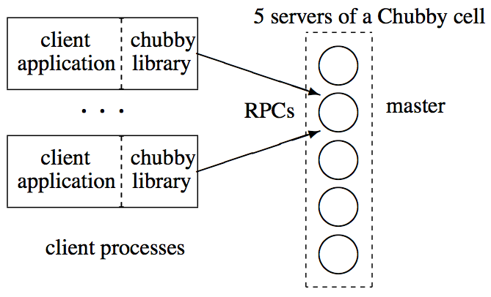
Chubby Organization
Chubby cell (an instance) has typically 5 replicas.
But each cell still serves tens of thousands of clients
Among 5 replicas, one master is elected.
Any one replica can be the master.
They decide who is the master via Paxos.
The master handles all requests.

Slide 28
Client Interface
File system interface
From a client’s point of view, it’s almost like accessing a file system.
Typical name: /ls/foo/wombat/pouch
ls (lock service) common to all Chubby names
foo is the name of the Chubby cell
/wombat/pouch interpreted within Chubby cell
Contains files and directories, called nodes
Any node can be a reader-writer lock: reader (shared) mode & writer (exclusive) mode
Files can contain a small piece of information
Just like a file system, each file is associated with some meta-data, such as access control lists.

Slide 29
Client-Chubby Interaction
Clients (library) send KeepAlive messages
Periodic handshakes
If Chubby doesn’t hear back from a client, it’s considered to be failed.
Clients can subscribed to events.
E.g., File contents modified, child node added, removed, or modified, lock become invalid, etc.
Clients cache data (file & meta data)
If the cached data becomes stale, the Chubby master invalidates it.
They Chubby master piggybacks events or cache invalidations on the KeepAlives
Ensures clients keep cache consistent

Slide 30
Client Lock Usage
Each lock has a “sequencer” that is roughly a version number.
Scenario
A process holding a lock L issues a request R
It then fails & lock gets freed.
Another process acquires L and perform some action before R arrives at Chubby.
R may be acted on without the protection of L, and potentially on inconsistent data.

Slide 31
Client API
open() & close()
GetContentsAndStat()
Reads the whole file and meta-data
SetContents()
Writes to the file
Acquire(), TryAcquire(), Release()
Acquires and releases a lock associated with the file
GetSequencer(), SetSequencer(), CheckSequencer()

Slide 32
Primary Election Example
All potential primaries open the lock file and attempt to acquire the lock.
One succeeds and becomes the primary, others become replicas.
Primary writes identity into the lock file with SetContents().
Clients and replicas read the lock file with GetContentsAndStat().
In response to a file-modification event.

Slide 33
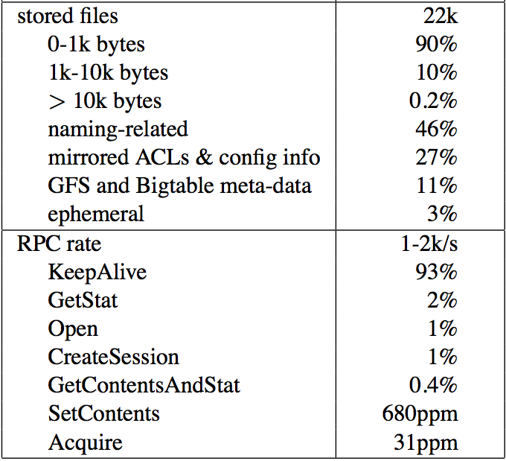
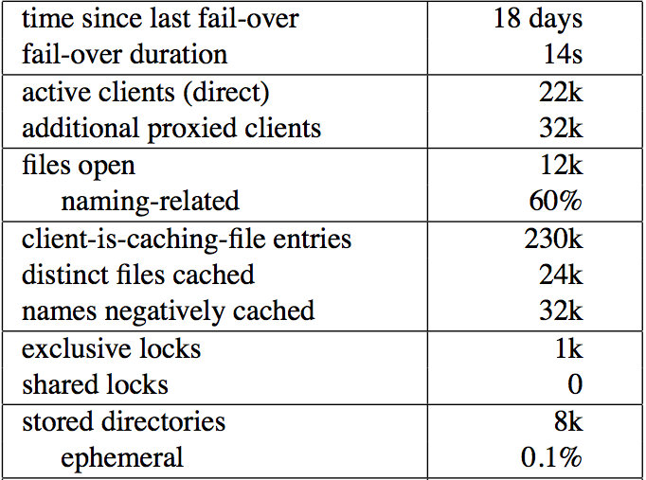
Chubby Usage
A snapshot of a Chubby cell
Few clients hold locks, and shared locks are rare.
Consistent with locking being used for primary election and partitioning data among replicas.

Slide 34
Acknowledgements
These slides contain material developed and copyrighted by Indranil Gupta (UIUC).

